Slide 1

Machine Learning for School Evaluation
Mazhar Mirza and Eva Pillossof

Slide 2


Overview
What is Machine Learning
School climate rating
College and Career Readiness Index (CCRI)
Leader/Teacher Effectiveness (LE/TE)
Beating the odds

Slide 3
Background Information
Key takeaways
Machine Learning is a sub-area of artificial intelligence, whereby the term refers to the ability of IT systems to independently find solutions to problems by recognizing patterns in databases.
Deep Learning is a subfield of Machine Learning concerned with algorithms inspired by the structure and function of the brain called artificial neural networks.
Both solve problems using high-level computing and immense amounts of data, which cannot be processed on an individual level.

Slide 4

Data
TIMSS open-source (1995 to 2015)
  Socioeconomic and assessment data for over 40 countries in Grades 4 and 8
PIRLS open-source (2011)
  Socioeconomic and assessment data for 12 countries
NWEA MAP (2012 to 2019)
  Assessment and classification data for over 800,000 students, time-tracked
Georgia, US Department of Education open-source (2011 to 2019)
  Whole-state school evaluations data
  Whole-state student assessment results (external and internal)
A total of over 20 billion individual data points

Slide 5
Definition and data
“School Climate refers to the quality and character of school life. School Climate is based on patterns of students’, parents’, and school personnel’s experience of school life and reflects norms, goals, values, interpersonal interactions, teaching and learning practices and organizational structures.” – National School Climate Center
Deep Learning algorithms found a strong correlation between School Climate and:
  Student academic achievement
  Student engagement
  Positive social skill development
Data used included:
  Student Health Survey (91 questions for Grade 6-12 and 15 question for Grades 3-5)
  Parent Survey (24 questions)
  School Staff Survey (31 questions)
School Climate
CCRI
LE/TE
BTO

Slide 6
Evaluation and minimal requirements
The Deep Learning algorithm assigned the following weights to evaluate the school climate:
  25% for survey results
  25% for students discipline (evaluated by weighing out positive vs. negative reinforcement techniques, i.e. suspensions, various interventions, etc.)
  25% for schoolwide attendance (including that of teachers and other school staff)
  25% for safe learning environment (using the ratio of bullying and violent incidents)
Minimum survey participation rates for accurate evaluation results:
  75% of student body
  75% of staff body
  50% of family body
School Climate
CCRI
LE/TE
BTO

Slide 7
Survey Analysis
Factor analysis by clustering to measure constructs
11 questions linked to direct measurement of macro school climate:
  I Like School
  I Feel Successful at School
  I feel my school has high standards for achievement
  My School Sets Clear Rules for Behavior
  I know what to do if there is an emergency at my school
  Teachers treat me with respect
  The behaviors in the classroom allow the teacher to teach so I can learn
  Students are frequently recognized for their good behavior
  I feel my school counselor would be helpful if I needed assistance
  I get along with other students and adults
  School is a place at which I feel safe
School Climate
CCRI
LE/TE
BTO

Slide 8
Survey Analysis
Safety
 | Rules and norms
 | Sense of physical security
 | Sense of socio-emotional security
T&L
 | Support for learning
 | Social and civic learning
Interpersonal Relationships
 | Respect for diversity
 | Social support from adults
 | Social support from students
Instructional Environment
 | School engagement
 | Physical surroundings
Clusters were identified in the following categories
School Climate
CCRI
LE/TE
BTO

Slide 9

Weighted suspension rate
Weighted suspension rate:
  $\left(1−\frac{\sum{Student weighted suspension rate}}{Total number of enrolled students}\right)∗100$
Suspension weights:
Only the maximum value is counted for each student to assure each student is counted once
Any number of ISS | 0.5 points
1-2 OSS | 1 point
3-4 OSS | 3 points
5-9 OSS | 5 points
More than 10 OSS | 7 points
Alternative class assignment | 6 points
Expulsion | 7 points
School Climate
CCRI
LE/TE
BTO

Slide 10
Safe Learning Environment and Attendance
% of students:
  Not engaged in violent discipline incidents
  Not engaged in substance use (includes vaping)
  Not engaged in bullying or harassment (includes cyber bullying)
Schoolwide attendance is evaluated by:
  % of students with absence less than 10% of lessons based on enrollment days (full-time enrollment or FTE)
    Includes only in-school instructional days where lessons are held
  Average daily attendance rates for:
    Teachers
    Administrators
    All other school staff
    Excluding professional development days and/or leave of more than 1 continuous month
School Climate
CCRI
LE/TE
BTO

Slide 11
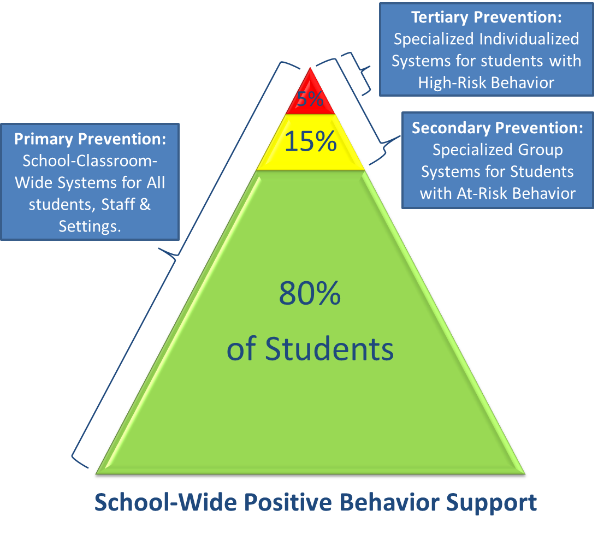
Additional Considerations
Long-term data overview shows a very strong correlation (r>0.9) between the implementation of Positive Behavioral Interventions and Support (PBIS) and:
  Weighted suspension rates
  Student academic achievement
  Student health survey results
It is critical to also monitor discipline disproportionality among risk groups, such as SEND, ELL, and EDS
School Climate
CCRI
LE/TE
BTO

Slide 12
Impact
1% increase in school climate score corresponded to an improvement in attainment results in core subjects (English, Math, and Science) for Grades 3-12 by 3% to 16%
The most impacted subject is Math, where the improvement was consistently over 3 times higher than in other subjects for the same school for every 1% increase in school climate score
Teacher/administrator experience did not correspond to improvement in, and therefore had no impact on school climate
Location did not impact school climate
1% increase in school climate corresponds to 1.35% decrease in discipline actions by student
1% increase in school climate corresponds to 1.6% increase in average daily attendance
Student and teacher/staff demographics do not significantly impact the development of positive school climate
School Climate
CCRI
LE/TE
BTO

Slide 13
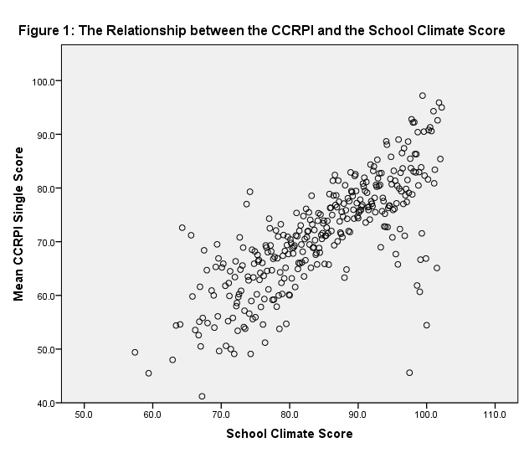
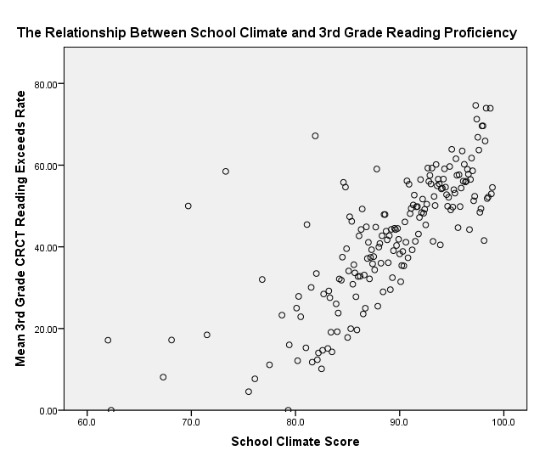
Impact
School Climate
CCRI
LE/TE
BTO

Slide 14




Components and Weights
30%
for all grade levels
Content Mastery
Measures whether students are achieving at the level necessary for the next grade, college, or career.
15-10%
for K-8 and 9-12
Closing Gaps
Measures whether all students and all subgroups are making improvements in achievement rates.
35-30%
for K-8 and 9-12
Progress
Measures how much growth students are demonstrating relative to academically similar students.
20-15%
for K-8 and 9-12
Readiness
Measures whether students are demonstrating preparedness for the next grade, college, or career.
15%
for 9-12 only
Graduation Rate
Measures whether students are graduating with a regular or advanced diploma in four years.
CCRI
School Climate
LE/TE
BTO

Slide 15
9-12 Content Mastery
Percent of students scoring at Meets or Exceeds on the 9th Grade Literature End of Course Test (required participation rate ≥ 95%)
Percent of students scoring at Meets or Exceeds on the 10th Grade Literature End of Course Test (required participation rate ≥ 95%)
Percent of students scoring at Meets or Exceeds on the Mathematics I/Algebra I End of Course Test (required participation rate ≥ 95%)
Percent of students scoring at Meets or Exceeds on the Mathematics II/Geometry End of Course Test (required participation rate ≥ 95%)
Percent of students scoring at Meets or Exceeds on the Physical Science End of Course Test (required participation rate ≥ 95%)
Percent of students scoring at Meets or Exceeds on the Biology End of Course Test (required participation rate ≥ 95%)
Percent of students scoring at Meets or Exceeds on the History End of Course Test (required participation rate ≥ 95%)
Percent of students scoring at Meets or Exceeds on the Humanities End of Course Test (required participation rate ≥ 95%)
CCRI
School Climate
LE/TE
BTO

Slide 16
K-8 Content Mastery
Percent of students scoring at Meets or Exceeds in ELA (required participation rate ≥ 95%)
Percent of students scoring at Meets or Exceeds in Reading (required participation rate ≥ 95%)
Percent of students scoring at Meets or Exceeds in Mathematics (required participation rate ≥ 95%)
Percent of students scoring at Meets or Exceeds in Science (required participation rate ≥ 95%)
Percent of students scoring at Meets or Exceeds in Social studies (required participation rate ≥ 95%)
CCRI
School Climate
LE/TE
BTO

Slide 17
Content Mastery Ratings and Rubrics
Students achieving the Developing Learners level will earn 0.5 (one-half) point.
Students achieving the Proficient Learners level will earn 1.0 (one) point.
Students achieving the Distinguished Learners level will earn 1.5 (one and one-half) points.
Grade Conversion Score Ranges
  Beginning Learner: 0-67
  Developing Learner: 68-79
  Proficient Learner: 80-91
  Distinguished Learner: 92-100
CCRI
School Climate
LE/TE
BTO

Slide 18
Achievement Levels
Beginning Learners do not yet demonstrate proficiency in the knowledge and skills necessary at this grade level/course of learning. The students need substantial academic support to be prepared for the next grade level or course and to be on track for college and career readiness.
Developing Learners demonstrate partial proficiency in the knowledge and skills necessary at this grade level/course of learning. The students need additional academic support to ensure success in the next grade level or course and to be on track for college and career readiness.
Proficient Learners demonstrate proficiency in the knowledge and skills necessary at this grade level/course of learning. The students are prepared for the next grade level or course and are on track for college and career readiness.
Distinguished Learners demonstrate advanced proficiency in the knowledge and skills necessary at this grade level/course of learning. The students are well prepared for the next grade level or course and are well prepared for college and career readiness.
CCRI
School Climate
LE/TE
BTO

Slide 19
Sample ELA Rubric
ALD | Standard | Beginning Learner | Developing Learner | Proficient Learner | Distinguished Learner
Policy |  | Beginning Learners do not yet demonstrate proficiency in the knowledge and skills necessary at this grade level/course of learning, as specified in Georgia’s content standards. The students need substantial academic support to be prepared for the next grade level or course and to be on track for college and career readiness. | Developing Learners demonstrate partial proficiency in the knowledge and skills necessary at this grade level/course of learning, as specified in Georgia’s content standards. The students need additional academic support to ensure success in the next grade level or course and to be on track for college and career readiness. | Proficient Learners demonstrate proficiency in the knowledge and skills necessary at this grade level/course of learning, as specified in Georgia’s content standards. The students are prepared for the next grade level or course and are on track for college and career readiness. | Distinguished Learners demonstrate advanced proficiency in the knowledge and skills necessary at this grade level/course of learning, as specified in Georgia’s content standards. The students are well prepared for the next grade level or course and are well prepared for college and career readiness.
Range |  | A student who achieves at the Beginning Learner level tends to read and comprehend informational texts and literature that do not meet the demands of grade level texts that would signal this student is on track for college and career readiness and requires substantial instructional support to improve reading skills. | A student who achieves at the Developing Learner level tends to read and comprehend informational texts and literature of low-to-moderate complexity and sometimes struggle to meet the demands of grade level texts that would signal this student is on track for college and career readiness and requires some instructional support to enhance reading skills. | A student who achieves at the Proficient Learner level reads and comprehends informational texts and literature of moderate-to-high complexity and is meeting the demands of grade level texts that signal this student is on track for college and career readiness. | A student who achieves at the Distinguished Learner level reads and comprehends informational texts and literature of high complexity and is meeting and often exceeding the demands of grade level texts that clearly signal this student is on track for college and career readiness.
 | 3.RL.1 | Answers simple questions to demonstrate understanding of texts. | Answers questions to demonstrate understanding of texts, referring to texts as the basis for answers. | Asks and answers questions to demonstrate understanding of texts, referring explicitly to texts as the basis for answers. | Asks and answers complex questions to demonstrate understanding of texts, referring explicitly to texts as the basis for answers.
CCRI
School Climate
LE/TE
BTO

Slide 20
Sample Math Rubric
ALD | Standard | Beginning Learner | Developing Learner | Proficient Learner | Distinguished Learner
Policy |  | Beginning Learners do not yet demonstrate proficiency in the knowledge and skills necessary at this grade level/course of learning, as specified in Georgia’s content standards. The students need substantial academic support to be prepared for the next grade level or course and to be on track for college and career readiness. | Developing Learners demonstrate partial proficiency in the knowledge and skills necessary at this grade level/course of learning, as specified in Georgia’s content standards. The students need additional academic support to ensure success in the next grade level or course and to be on track for college and career readiness. | Proficient Learners demonstrate proficiency in the knowledge and skills necessary at this grade level/course of learning, as specified in Georgia’s content standards. The students are prepared for the next grade level or course and are on track for college and career readiness. | Distinguished Learners demonstrate advanced proficiency in the knowledge and skills necessary at this grade level/course of learning, as specified in Georgia’s content standards. The students are well prepared for the next grade level or course and are well prepared for college and career readiness.
Range |  | A student who achieves at the Beginning Learner level demonstrates minimal command of the grade-level standards. | A student who achieves at the Developing Learner level demonstrates partial command of the grade-level standards. | A student who achieves at the Proficient Learner level demonstrates proficiency of the grade-level standards. | A student who achieves at the Distinguished Learner level demonstrates advanced proficiency of the grade-level standards.
 | 3.NBT.1 3.NBT.2 3.NBT.3 | Understands place value to 1000 and multiplies single-digit numbers. | Adds and subtracts within 1000. | Uses place value relationships to round numbers, multiplies whole numbers by multiples of ten, adds and subtracts fluently, and explains arithmetic patterns. | Recognizes that each place value, left to right, is ten times the one before it, rounding to specific whole-number place values, and multiplies multiples of ten by each other.
CCRI
School Climate
LE/TE
BTO

Slide 21
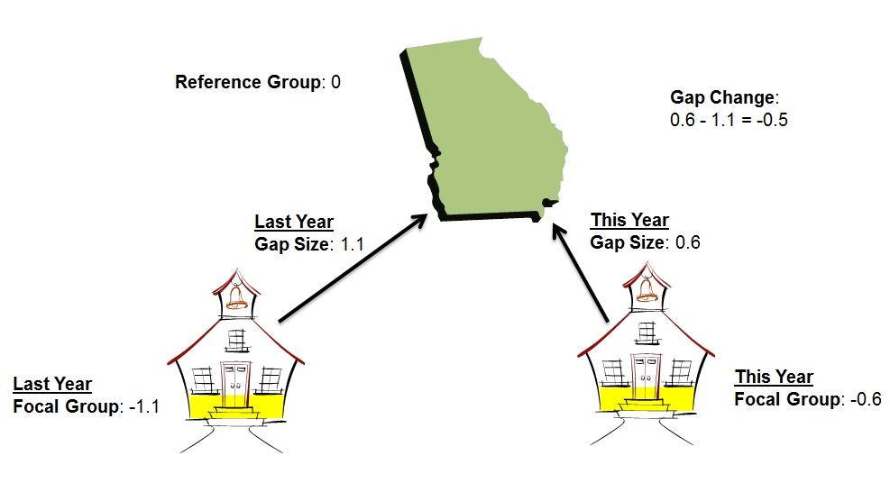
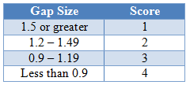
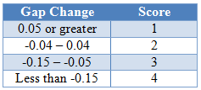
Achievement Gap
Achievement Gap considers Gap Size and Gap Change
For these calculations, the scale scores for full academic year (FAY) students are converted to ƶ scores
The goal of measuring achievement gap reduction is to focus on increasing the achievement of the schools’ lowest achieving students relative to the norms and world averages
Achievement Gap points on the CCRI are derived by first calculating the achievement gap size and the achievement gap change for a school
CCRI
School Climate
LE/TE
BTO

Slide 22
Progress
The Student Growth Percentile (SGP) describes a student’s growth relative to other students with similar prior achievement
Each student obtains a growth percentile, indicating his or her “rank” on current achievement relative to other students with similar score histories (worldwide)
A student’s growth percentile can range from 1 to 99
Every student’s SGP has the potential to earn points towards the Progress Score
Progress calculations will utilize SGPs for FAY students
Students shall attend 90% of the instructional length of the course in order for the student’s data to be included in the growth score for evaluation. Please note this attendance requirement will be phased in over a three year period
SGPs can be compared across grade levels and across subject areas, meaning summary measures also can be aggregated across grade levels and subject areas and describes growth in terms of how a student performed in the current year relative to other students who have a similar academic history
SGP rages are: low (0-34), typical (35-65), and high (66-99)
CCRI
School Climate
LE/TE
BTO

Slide 23
9-12 Readiness
Percent of graduates completing an engineering/medicine pathway, or an advanced academic pathway, or a fine arts pathway, or a world language pathway within their program of study
Percent of engineering/medicine pathway students who complete AP assessments successfully
Percent of graduates proceeding to the army, or police academy, or vocational school not requiring remediation or learning support courses; or scoring at least 1550 out of 2400 on the combined SAT; or scoring 3 or higher on two or more AP exams; or scoring 4 or higher on two or more IB exams
Percent of graduates earning high school credit(s) for accelerated enrollment via Early College, Gateway to College, Advanced Placement courses, or International Baccalaureate courses
Percent of graduates earning 2 or more high school credits in the same world language
Percent of students scoring at Meets or Exceeds on the TOEFL/IELTS Writing Test
Percent of students achieving a Lexile measure greater than or equal to 1275
Student Attendance Rate (%)
Cohort Graduation Rate (%)
CCRI
School Climate
LE/TE
BTO

Slide 24
K-8 Readiness
Percent of English Learners with positive movement from one Performance Band to a higher Performance Band as measured by the WIDA for ELLs
Percent of Students With Disabilities served in general education environments greater than 80% of the school day
Percent of students scoring at Meets or Exceeds on the 5/8th Grade Writing Assessment (required participation rate ≥ 95%)
Percent of students in grade 3 achieving a Lexile measure equal to or greater than 650
Percent of students in grade 5 achieving a Lexile measure equal to or greater than 850
Percent of students in grade 8 achieving a Lexile measure equal to or greater than 1050
Percent of students in grades 1-5 completing identified number of grade specific career awareness lessons
Percent of students completing 2 or more defined career related assessments by the end of grade 8
Percent of students with a complete defined Individual Graduation Plan by the end of grade 8
Student Attendance Rate by subject (%)
CCRI
School Climate
LE/TE
BTO

Slide 25
9-12 Exceeding the Bar
In addition to the items within the CCRI, high schools may earn additional points for these supplemental indicators.
Percent of graduates taking a nationally recognized college entrance examination
Percent of graduates earning credit in a Chemistry course
Percent of first time 9th grade students with disabilities earning 3 credits in 3 core content areas (ELA, mathematics, science, social studies)
Percent of first time 9th grade students earning 4 credits in 4 core content areas (ELA, mathematics, science, social studies)
Percent of English Learners with positive movement from one Performance Band to a higher Performance Band based on WIDA for ELLs
Percent of students in International Baccalaureate High Schools (IB) completing IB Career-Related Certificates or equivalent for AP
School innovative practice accompanied by documented data supporting improved student achievement: examples include but are not limited to students enrolled in a College and Career Academy, participation in reader initiatives, participation in dual language immersion program, participation in Literacy Design Collaborative (LDC) and/or Mathematics Design Collaborative (MDC), comprehensive implementation of Response to Intervention (RTI) and/or Positive Behavioral Interventions & Supports (PBIS)
School interventions or practices designed to facilitate a personalized climate in the school: examples include but are not limited to comprehensive Teachers as Advisors program, comprehensive mentoring program, service-learning programs, peer mediation, conflict mediation
CCRI
School Climate
LE/TE
BTO

Slide 26
K-8 Exceeding the Bar
In addition to the items within the CCRI, middle and elementary schools may earn additional points for these supplemental indicators.
Percent of students in grades K-8 earning a passing score in above grade level core courses (ELA, mathematics, science, social studies)
Percent of students earning a passing score in three elementary/middle school courses in the fine arts, or career exploratory, or world languages by the end of grade 5/8 (courses must be in the same area of concentration)
Percent of students earning at least one middle/high school credit by the end of grade 5/8 (ELA, mathematics, science, social studies, world languages, fine arts)
Percent of students in grade 5/8 scoring proficient/advanced on the 21st Century Skills Technology Assessment
Percent of students in grades K-8 with a fully documented Fitnessgram assessment
School innovative practice accompanied by documented data supporting improved student achievement: examples include but are not limited to students enrolled in a College and Career Academy, participation in reader initiatives, participation in dual language immersion program, participation in Literacy Design Collaborative (LDC) and/or Mathematics Design Collaborative (MDC), comprehensive implementation of Response to Intervention (RTI) and/or Positive Behavioral Interventions & Supports (PBIS)
School interventions or practices designed to facilitate a personalized climate in the school: examples include but are not limited to comprehensive Teachers as Advisors program, comprehensive mentoring program, service-learning programs, peer mediation, conflict mediation
CCRI
School Climate
LE/TE
BTO

Slide 27
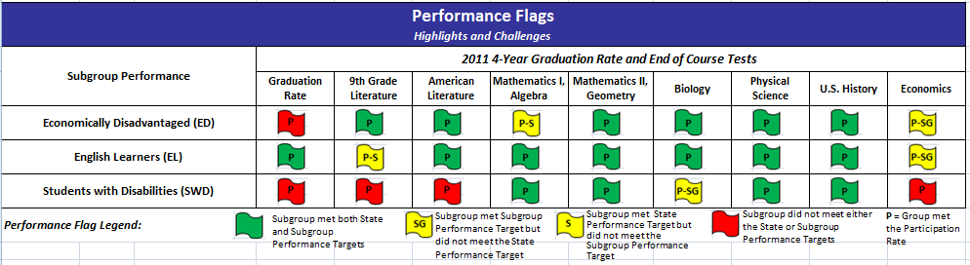
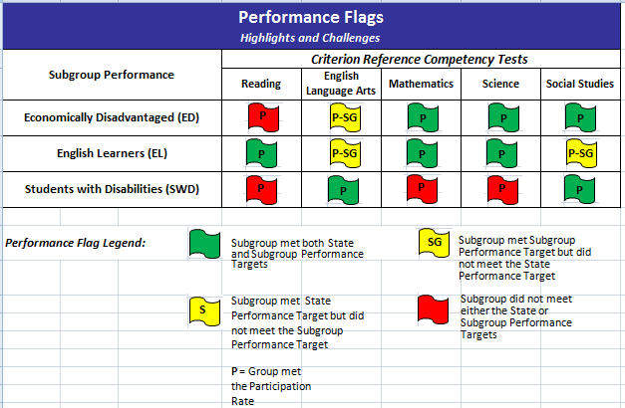
Additional Considerations
CCRI
School Climate
LE/TE
BTO

Slide 28

Evaluating Staff
For leaders:
  30% Leader’s Results on Performance Standards (LRPS)
  40% Student Growth
  10% School Climate
  20% CCRI, Achievemnt Gap Reduction, and BTO
For teachers:
  50% Teacher’s Results on Performance Standards (TRPS)
  30% Student Growth
  20% Professional Growth
LE/TE
School Climate
CCRI
BTO

Slide 29
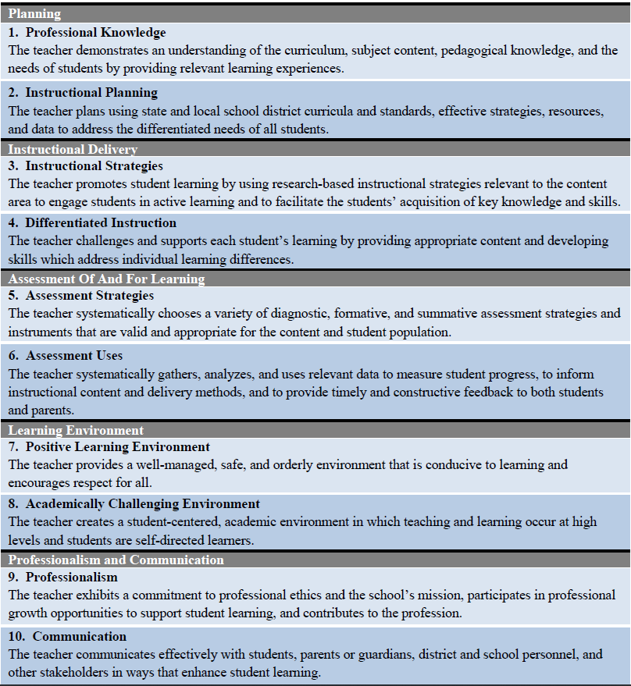
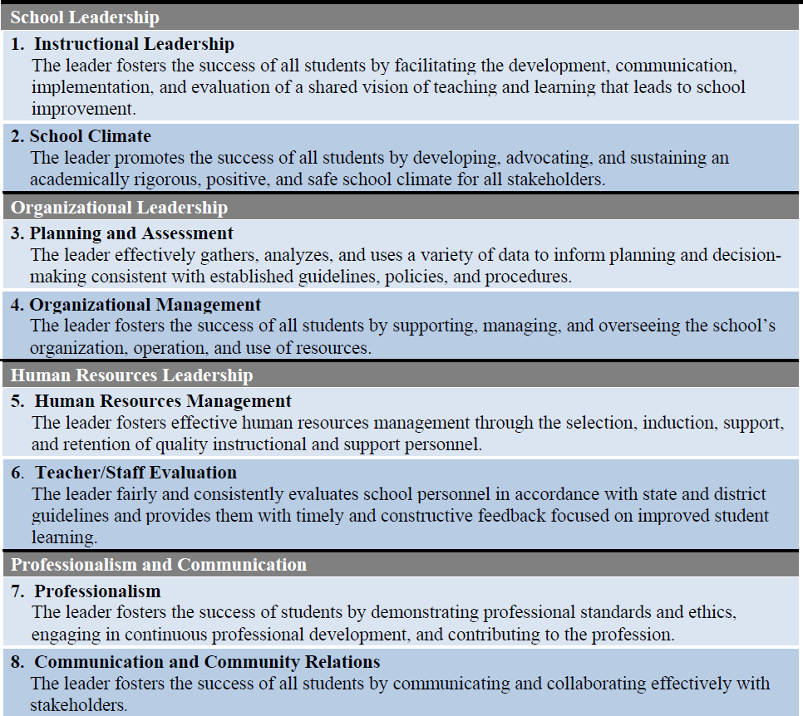
LRPS/TRPS
LE/TE
School Climate
CCRI
BTO

Slide 30
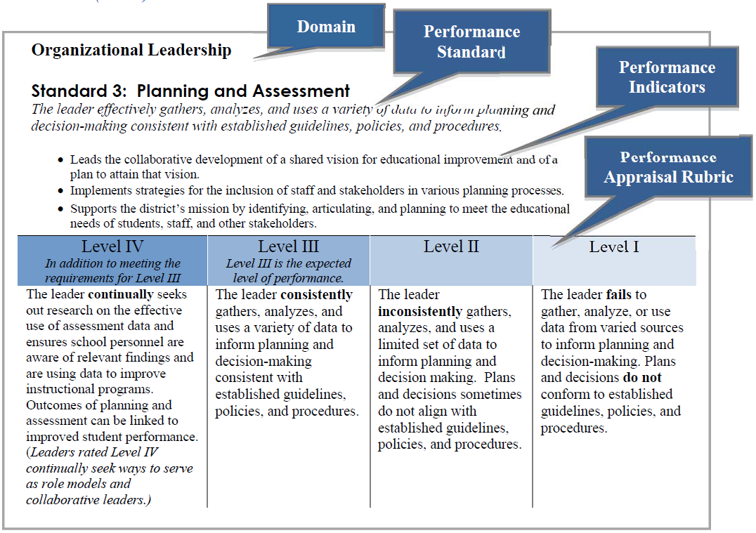
Sample Rubrics
LE/TE
School Climate
CCRI
BTO

Slide 31
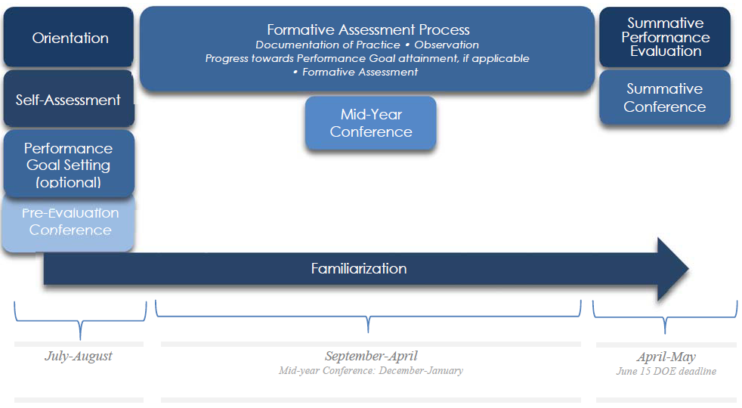
Process Timeline
LE/TE
School Climate
CCRI
BTO

Slide 32
Overall Rating Calculations
Final Ratings | LRPS/TRPS Sum Score Ranges
Level I | 0-5/0-6
Level II | 6-13/7-16
Level III | 14-21/17-26
Level IV | 22-24/27-30
Rating | Sum of Component Parts
Exemplary | ≥3.5
Proficient | ≥2.5 and <3.5
Needs Development | ≥1.5 and <2.5
Ineffective | <1.5
Final Ratings | Mean GP Score Ranges
Level I | <35
Level II | ≥35 and ≤45
Level III | >45 and ≤60
Level IV | >60
LE/TE
School Climate
CCRI
BTO

Slide 33
BTO Analysis
A cross-sectional, fixed-effects regression model
Student-based factors:
  % Emirati
  % SEND
  % ELL
  % G&T
  % Boys
  % EDS
School-based factors:
  School size
  Location type
  Student/Teacher ratio
  District performance
  CCRI score type
BTO
School Climate
CCRI
LE/TE

Slide 34
BTO Model
Predictive regression model:
Y_{i} = β₀ + β₁SD_{i} + β₂SI_{i} + β₃CL_{i} + ε_{i} + α_{d}
β₀ ₌ constant term
β₁SD_{i} = vector of student demographic variables for each individual school
β₂SI_{i} = vector of school type information including school size, student-teacher ratio, and location type
β₃CL_{i} = dummy (binary) variables for each of the CCRI reporting clusters (i.e. Elementary, Middle, High)
ε_{i} = individual schools’ random error term
α_{d} = district level fixed-effects to control for district-level policies and procedures
Linear prediction from the fitted regression model where:
  estimating a set of parameters b₁, b₂, : : : , b_{k}, and the linear prediction is:
  For the linear regression model selected the values are called the predicted values.
x_{1j}, x_{2j} , : : : , x_{kj} are obtained from the actual reported school level data on the student-based and school level predictors
BTO
School Climate
CCRI
LE/TE

Slide 35
Conclusions
Better targeted areas for development
Better identification of successful teachers/leaders
Better college and career readiness
Better identification of BTO schools
Better worldwide competitiveness

